Slide 1

IMAGE CAPTIONING MODEL
A
MINOR PROJECT
Submitted in partial fulfillment for the award of the Degree of
MASTER OF COMPUTER APPLICATIONS
Under the Guidance of
Mr. Jay Narayan Thakre
Assistant professor
Department of computer applications
UIT, RGPV, Bhopal
Submitted by
SUJEET P SINGH
0101CA241063
MCA III semester

Slide 2
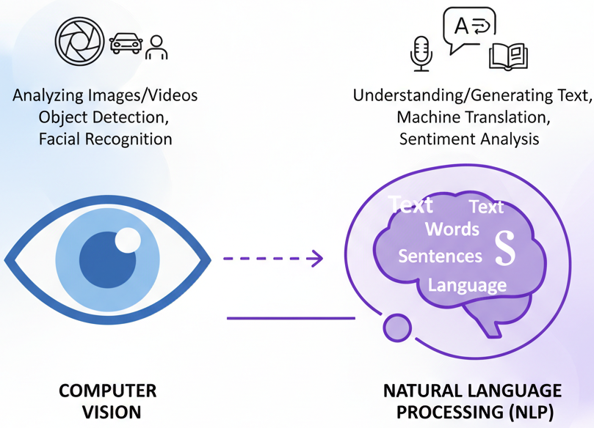
What is Image Captioning?
The process of generating a textual description of an image.
It requires the model to understand what is in the image (Computer Vision) and how to describe it grammatically (Natural Language Processing).
The Problem:
Computers see images as grids of pixels (numbers).
The challenge is mapping these pixel values to a sequence
of meaningful words.
Applications:
Assistance for the visually impaired (describing surroundings).
Automated content indexing for search engines.
Social media analysis.

Slide 3
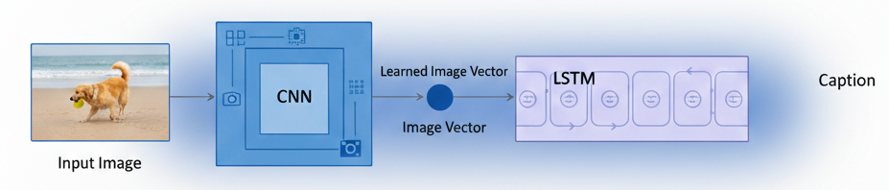
System Architecture (The Blueprint)
The "Encoder-Decoder" Model:
To utilize a standard deep learning architecture for sequence-to-sequence tasks.
Encoder (The Eye): CNN (Convolutional Neural Network): Used to extract feature vectors from the input image. Model Used is InceptionV3 (Pre-trained on ImageNet).
Decoder (The Brain): RNN (Recurrent Neural Network): Used to generate the caption word-by-word. Model Used is LSTM (Long Short-Term Memory) network to handle long-term dependencies.

Slide 4
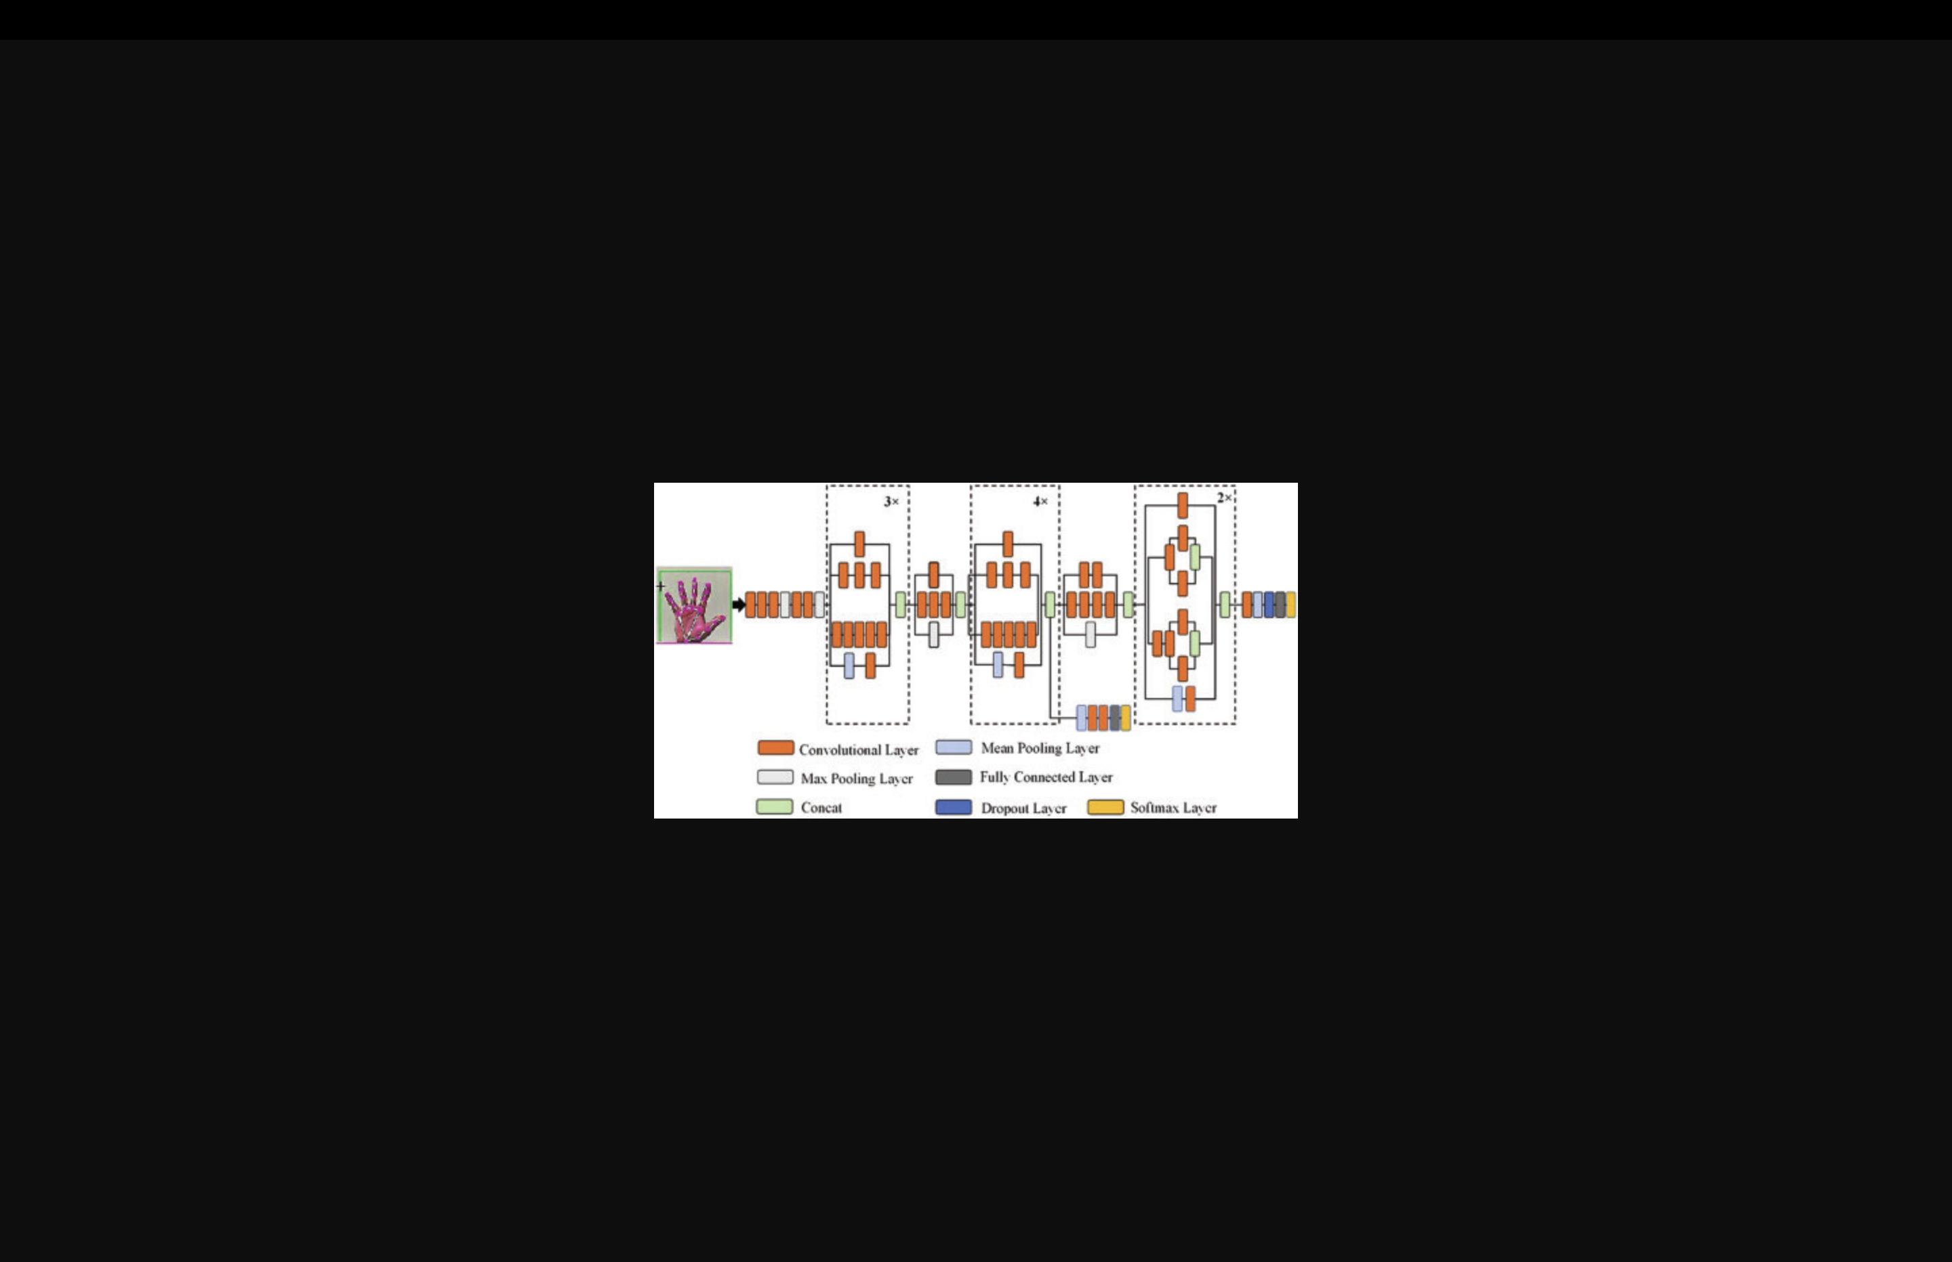
The Encoder - Feature Extraction
InceptionV3 Model:
A powerful CNN pre-trained on the ImageNet dataset
(1000 categories).
Transfer Learning: We remove the final "Classification Layer". We use the output of the second-to-last layer.
Output: A fixed-length vector (typically 2048 dimensions)
Why InceptionV3?
High accuracy, manageable computational cost, and excellent at detecting objects/textures.

Slide 5
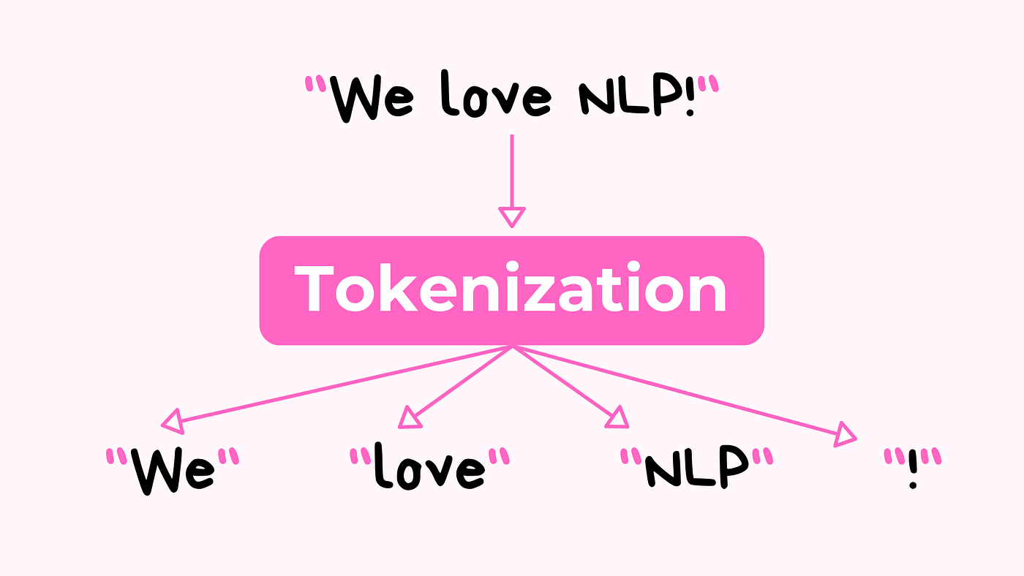
Data Preprocessing & Tokenization
Dataset
MS COCO (Microsoft Common Objects in Context).
Contains >100k images, each with 5 human-written captions.
Text Preprocessing
Tokenization: Converting words into integers (e.g., "Cat" -> 452).
Vocabulary: Limiting to the top 5,000-10,000 most frequent words to reduce model size.
Special Tokens: Adding <start> to initiate generation and <end> to stop it.
Padding: Ensuring all caption sequences are the same length for batch processing.

Slide 6
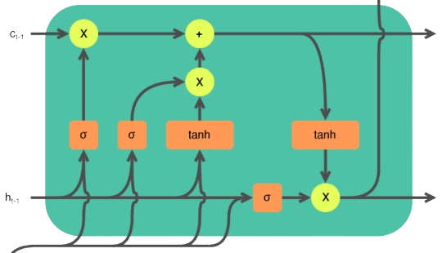
The Decoder - LSTM Implementation
How it Works:
Input: Takes the Image Feature Vector + The word generated in the previous step.
Embedding Layer: Converts integer tokens into dense vectors.
LSTM Cells: Maintains a "memory" of the sentence context (e.g., knowing "A man is..." implies the next word is likely a verb like "running").
Output: A probability distribution over the entire vocabulary (predicting the most likely next word).

Slide 7
Evaluation Metrics
BLEU Score (Bilingual Evaluation Understudy)
The industry standard for evaluating machine-generated text.
It compares the n-grams (sequences of words) of the generated caption against the reference (human) captions.
BLEU-1: Unigram precision (individual words).
BLEU-4: 4-gram precision (phrasing and fluency).
Loss Function:
Categorical Cross-Entropy: Used during training to minimize the difference between the predicted word probability and the actual word.

Slide 8
Implementation Challenges & Optimization
Challenges Faced
Resource Intensity: Training the CNN+LSTM from scratch on MS COCO requires massive GPU VRAM (typically A100 clusters) and takes days/weeks.
Inference Latency: The LSTM architecture is slow during real-time generation for a web app.
Deployment Constraints: Integrating the massive custom-trained weights into a frontend API caused memory timeouts on standard hosting.
The Solution
For the final application deployment, i optimized by utilizing a Vision-Transformer architecture.
I utilized the Hugging Face Transformers library to implement a state-of-the-art model (BLIP) that offers superior efficiency for web deployment while maintaining the underlying Encoder-Decoder logic.

Slide 9
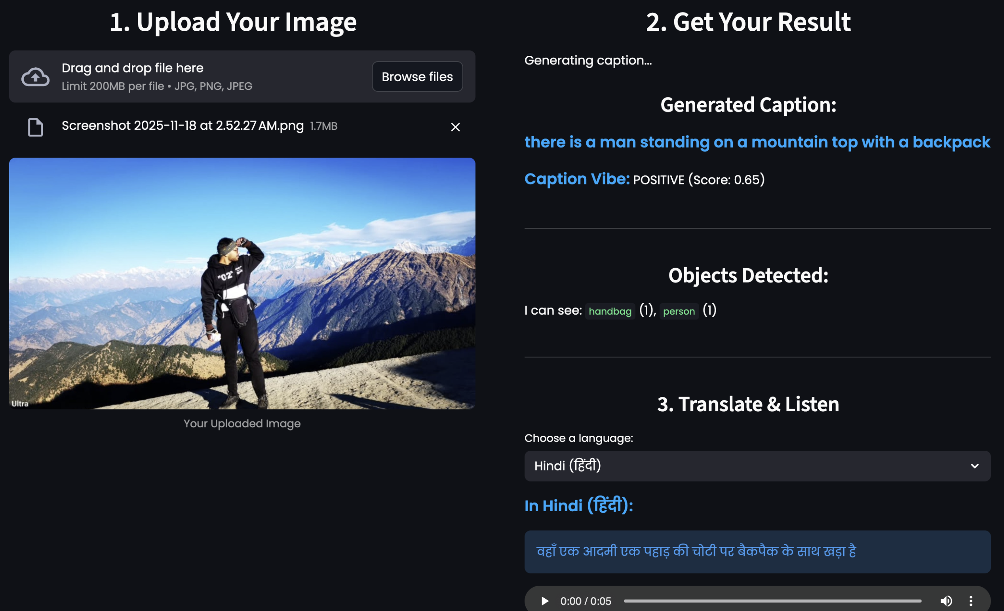
Project Demo - Karmatix Image Captioning
Tech Stack
Frontend: Streamlit (Python).
Backend Logic: PyTorch & Transformers.
Features Implemented
Real-time Captioning: Instant generation.
Multi-Language Support: Integration with Google Translate API.
Accessibility: Text-to-Speech (gTTS) integration.
Object Detection: Additional layer for identifying specific items.

Slide 10
Conclusion & Future Scope
Conclusion
Successfully understood the end-to-end pipeline of Image Captioning: Data Prep -> Feature Extraction -> Sequence Generation.
Built a functional, user-friendly web application.
Future Scope
Attention Mechanisms: Visualizing exactly which part of the image the model looks at for each word.
Video Captioning: Extending the model to process video frames.
Real-Time Edge Deployment: Optimizing the model to run on mobile phones.

